Slide 1
C# Secondary Developing

Slide 2
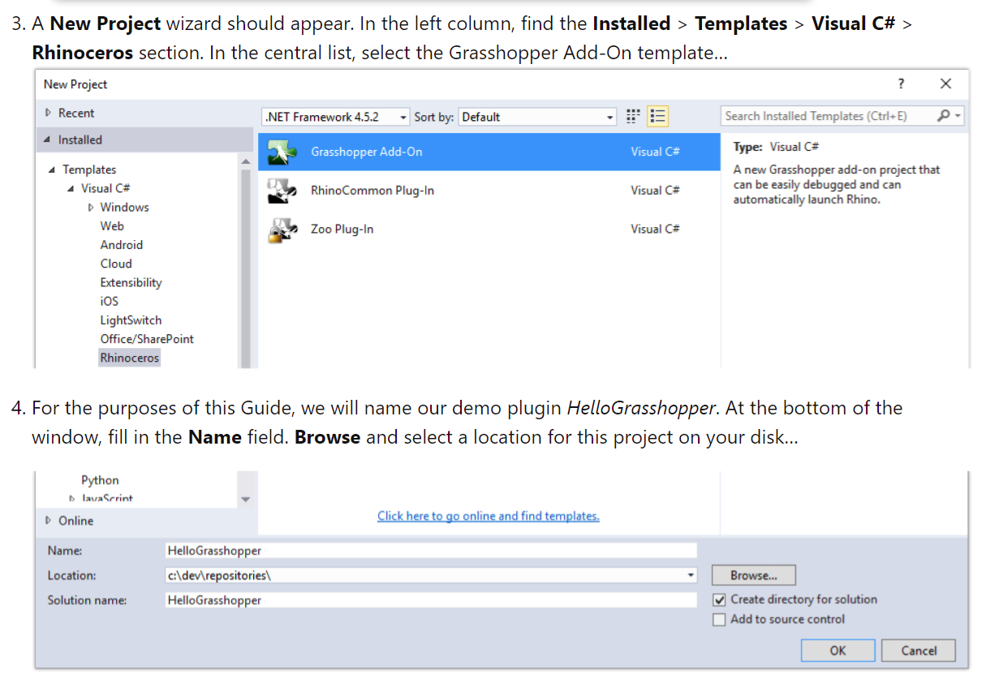
Tool to use
Language: C#
IDE: Visual Studio
Note:
Right now(2021)
The Grasshopper add on for Visual Studio can only run with Rhino 6
Make sure u download the wright tool kit
For more detail go to “here”

Slide 3
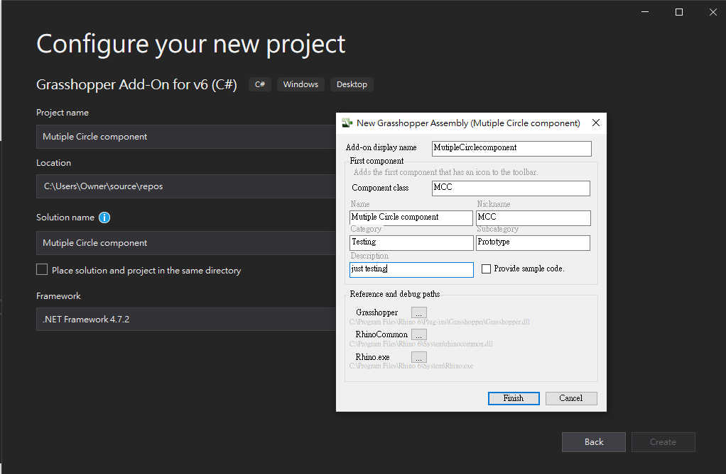

Slide 4
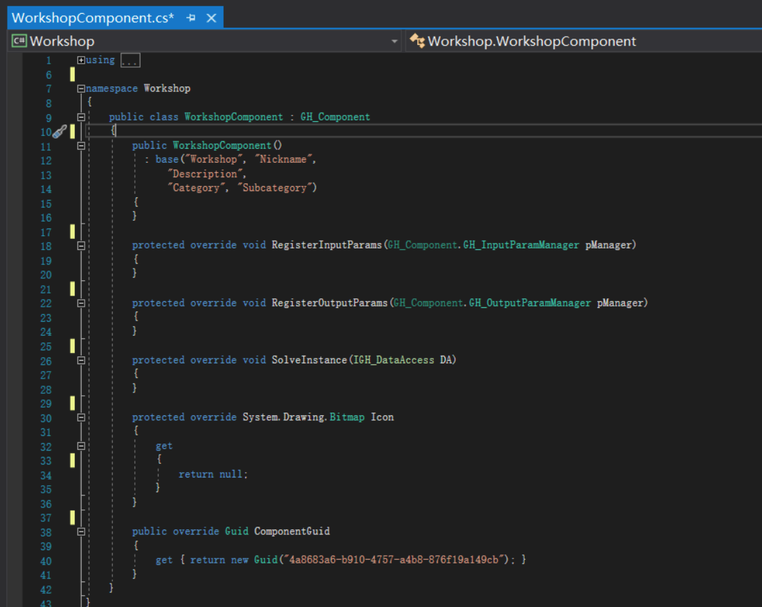
Main structure of the Grasshopper C#
0.This section will decide which section your designing component will appear(mostly string nothing tricky)
1. Here is the input section
2. Here is the output section
3. Here is the main action section(where all the magic happend)
4. This section given access to change and assign icon.

Slide 5
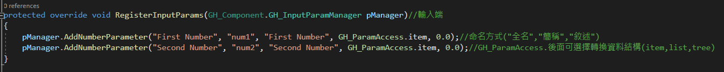
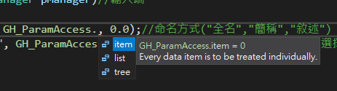
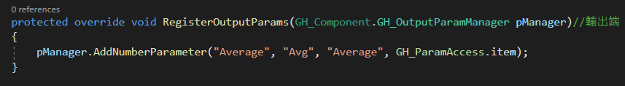
1~2 Section: Input /Output Section
Input section
Full title of the component
Nick name of the component
Description for component
Output section
Changing Data type through
GH_ParaAccess.item
.list
.tree

Slide 6
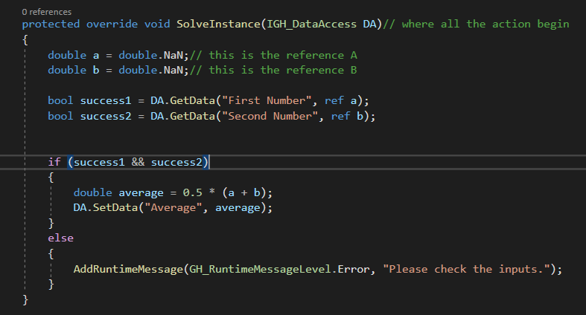
3 section: Solve Instance Section
If successfully get data from reference a/b it will return Boolean value to tell whether its successful or not.
If both input return “True”, then the program will start to execute what ever you type in this section.
If the input data has any problem it will return what ever string that you type in here.

Slide 7
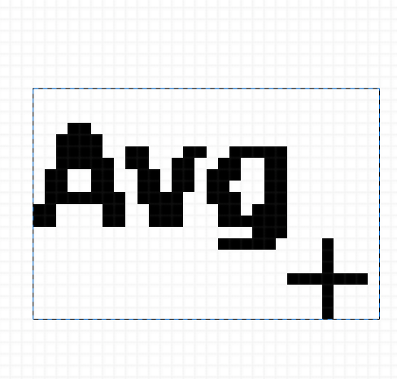
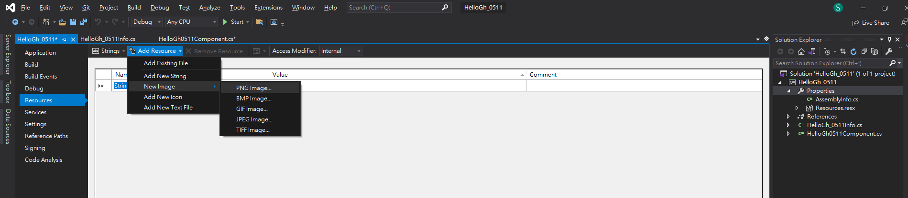
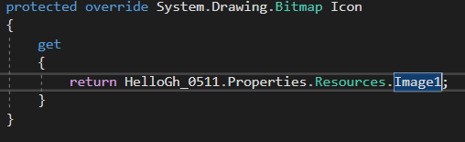
4. Icon section
Hit property
resources→add Resource→NewImage
Or
Add Existing File.
After Add icon into resources, change this section to the Following

Slide 8
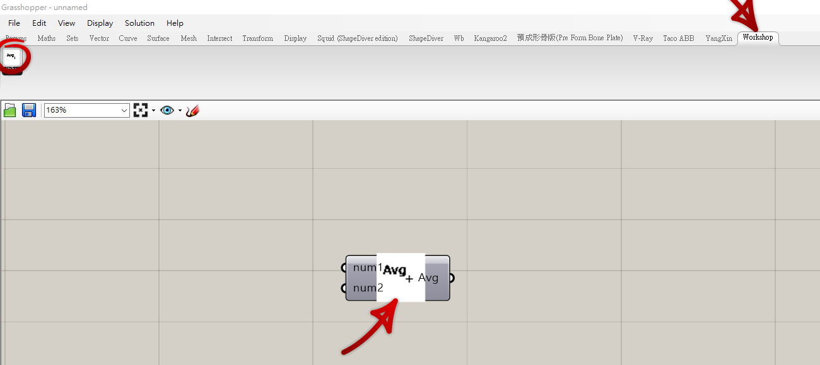
Result
Got to hit debug, then it will go set up Rhino6, then open GH automatically, for more setting detail go “here”

